Slide 1
Web Application
Waqar Yar

Slide 2
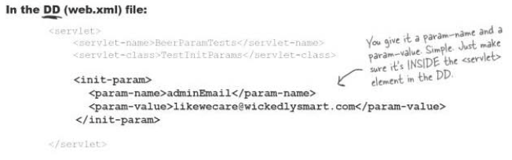
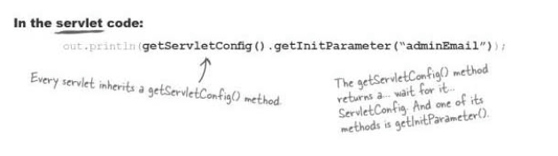
Init Parmeters
This is a way to initialize parameters in Servlets.

Slide 3
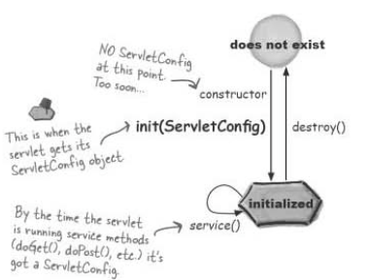
Init Parameters
When the container initializes a servlet it makes a unique ServletConfig for the servlet.
The container reads the servlet init parameters from the DD and gives them to the ServletConfig. Then passes the ServletConfig to the servlets’s init() method.

Slide 4
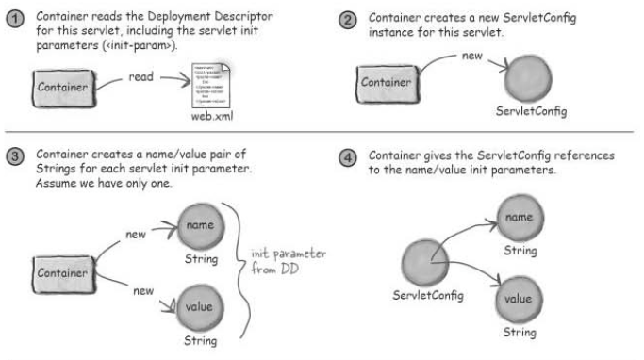
Init Parameters

Slide 5
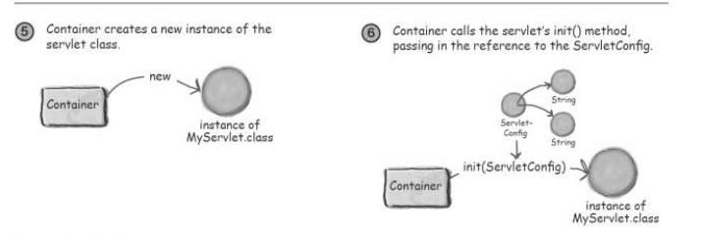
Init Parameters

Slide 6
Context Init parameter
Context Init parameter works like servlet int Parameter , except context parameter are available to the entire webapp.
When the value changes it has to be changed in only one palce.

Slide 7
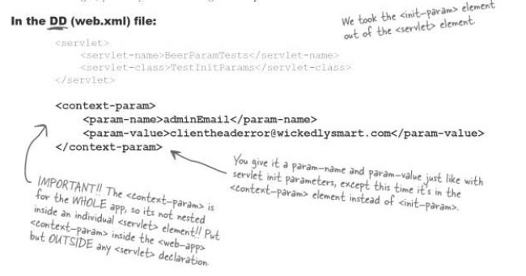
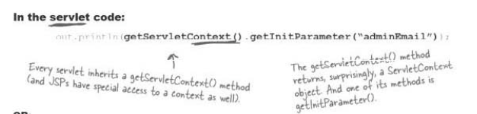

Slide 8
ServletContext
Container reads the DD and creates the name\value pair.
Container creates a new instance of ServletContext.
Container gives the ServletContext a reference to each name\value pair of the context init parameter.
Every servlet and JSP deployed as part of a single web app has access to that same ServletContext.

Slide 9
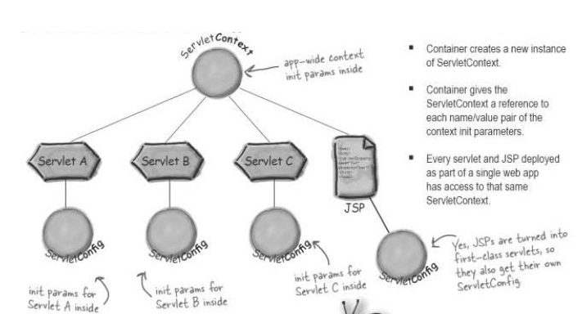

Slide 10
ServletContext Listener
A ServletContextListener is used to run some code before the rest of the application can service a client.
To Listen for ServletContext events write a listener class that implements ServletContextListener
Put this class in the WEB-INF classes directory.
Put the listener element in the Deployment Descriptor.

